Slide 1


Aliya Kaldybayeva
27/01/23

Slide 2

Outline
Executive Summary
Introduction
Methodology
Results
Conclusion
Appendix

Slide 3
Introduction
In this project we will predict whether SpaceX Falcon 9 will land successfully. TO achieve that we will use several machine learning techniques.
The main steps:
Data collection methodology
Data wrangling
Exploratory data analysis (EDA) using visualization and SQL
Interactive visual analytics using Folium and Plotly Dash
Predictive analysis using classification models

Slide 4

Section 1

Slide 5
Methodology
Executive Summary
Data collection methodology
Api, Web scraping
Data wrangling
Pandas, Numpy , SQL
Data visualization
Matplotlib, seaborn , Folium, Dash
Predictive analysis:
Logistic , KNN , SVM, Decision trees

Slide 6
Data Collection
I had two data sources:
1. API (https://api.spacexdata.com/v4/rockets/)
2. Webscraping (List of Falcon 9 and Falcon Heavy launches – Wikipedia)
I used get.requests() and BeautifulSoup() commands

Slide 7
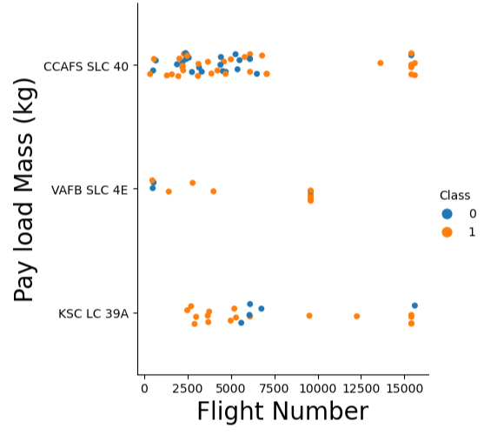
EDA with Data Visualization
I plotted different charts to understand the relationship of the variables with dependent variable. This was done to understand which variables are more likely to have impact on my final variable target.
Example of the plot. More plots can be found here

Slide 8
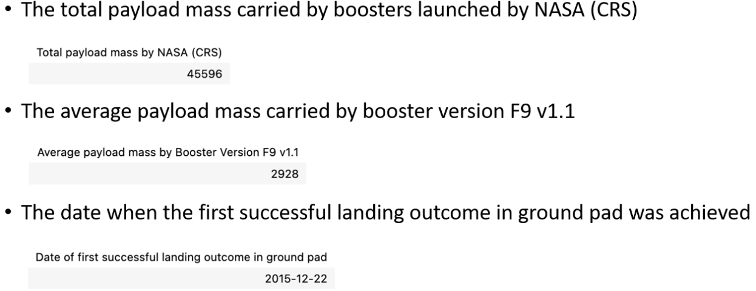
EDA with SQL

Slide 9
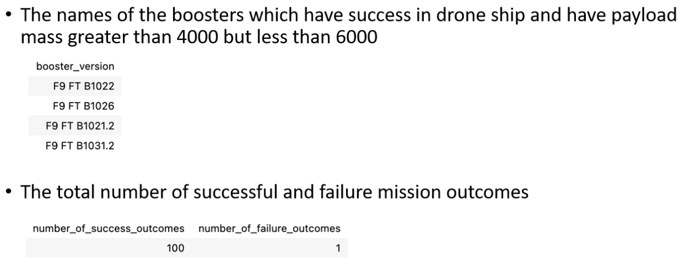
EDA with SQL

Slide 10
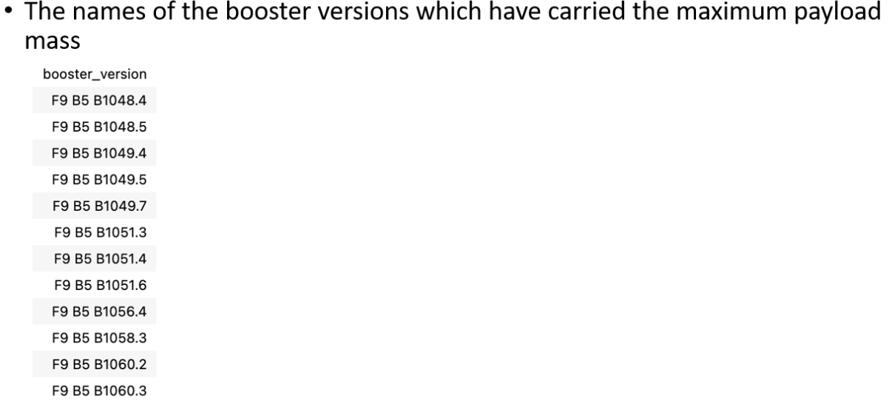
EDA with SQL

Slide 11
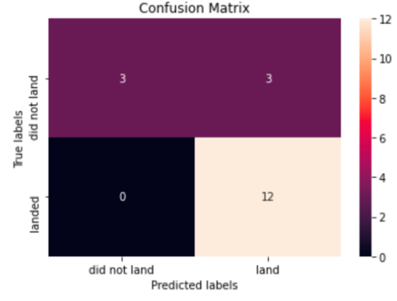
Predictive Analysis (DT)
Decision tree
GridSearchCV best score: 0.889285714
Accuracy score: 0.8333333333

Slide 12
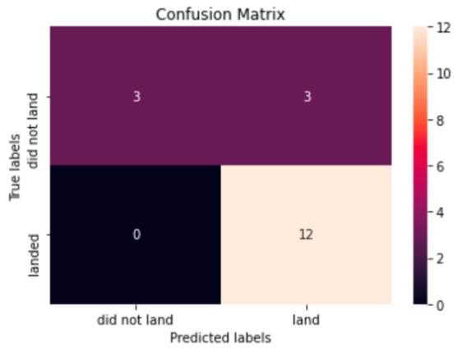
Predictive Analysis (Classification)
Logistic
GridSearchCV best score: 0.846428571428
Accuracy score: 0.8333333333

Slide 13
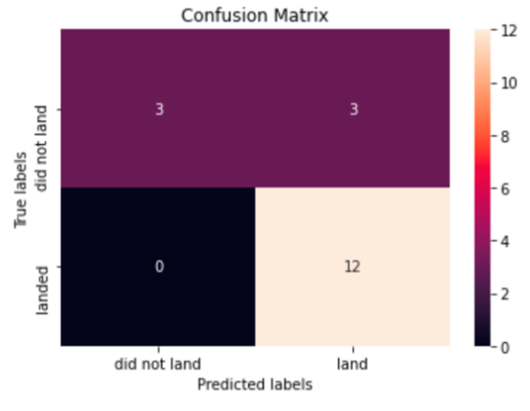
Predictive Analysis (SVM)
SVM
GridSearchCV best score: 0.848214285714
Accuracy score: 0.8333333333

Slide 14
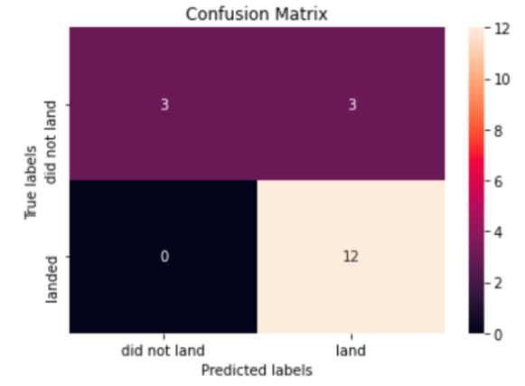
Predictive Analysis (SVM)
KNN
GridSearchCV best score: 0.848214285714
Accuracy score: 0.8333333333

Slide 15
Results
The best model by ranking them through GridSearchCV:
Decision tree
KNN
SVM
Logistic

Slide 16


